Slide 1
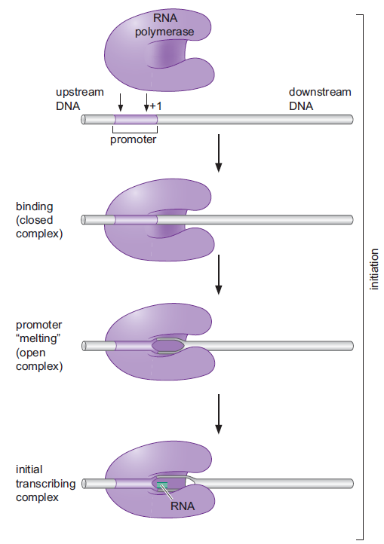
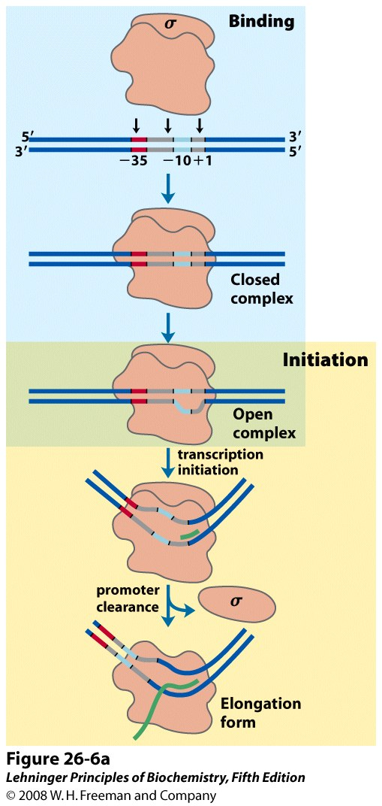
Mechanism of transcription initiation and elongation
Lecture - 15

Slide 2
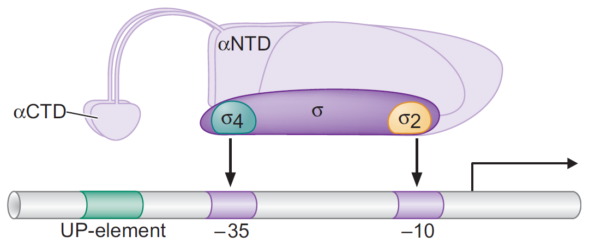
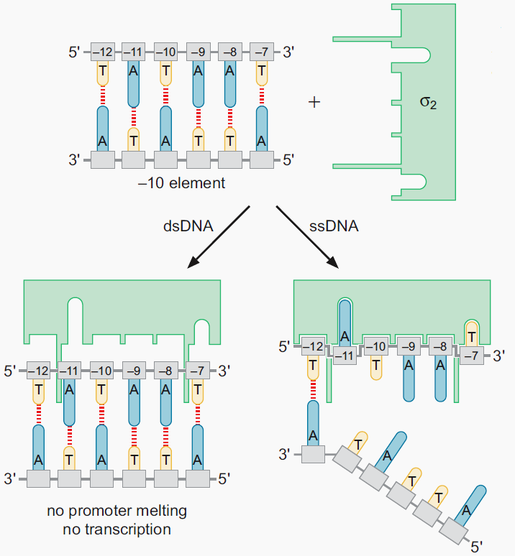
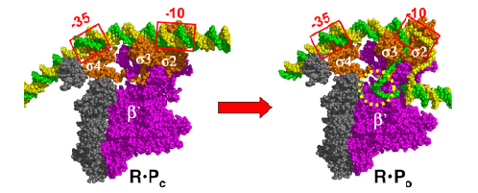
Promoter melting by RNA polymerase
Notes:
Sigma factors are subunits of all bacterial RNA polymerases. They are responsible for determining the specificity of promoter DNA binding and control how efficiently RNA synthesis (transcription) is initiated. The first sigma factor discovered was the sigma70 (σ⁷⁰) of the highly studied bacterium Escherichia coli. Its discovery in 1968 was an

Slide 3
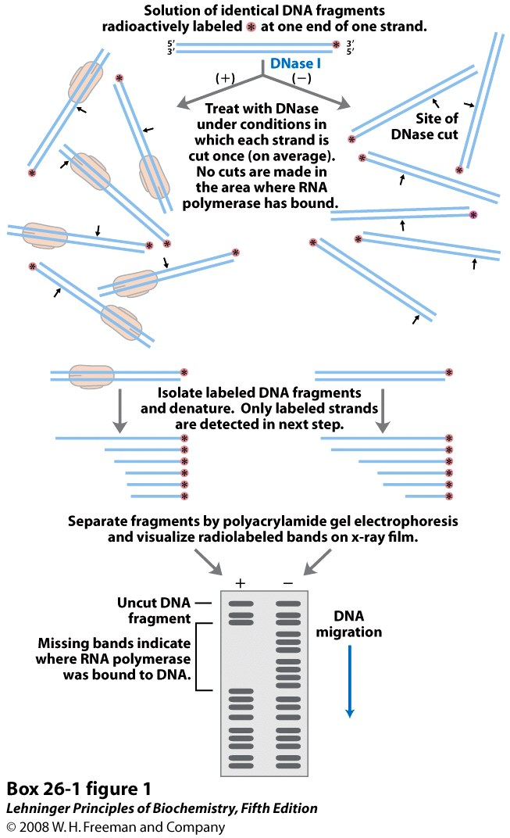
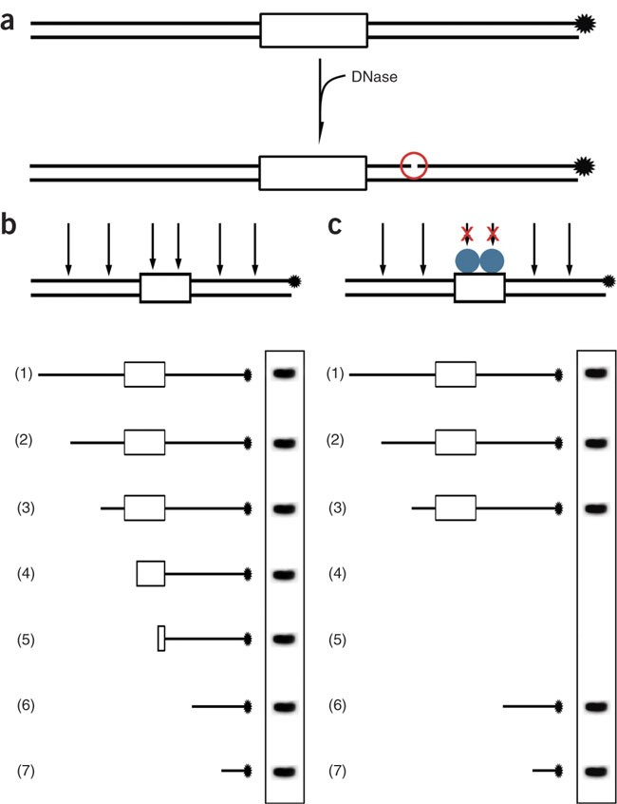
RNA polymerase-promoter interaction
Electrophoretic mobility shift assay (EMSA) and DNase foot printing assay

Slide 4
Abortive initiation
Abortive initiation is an early process of transcription in which RNA polymerase binds to a DNA promoter and enters into cycles of synthesis of short mRNA transcripts which are released before the transcription complex leaves the promoter.
Notes:
As we have outlined, during initial transcription, RNA polymerase produces
and releases short RNA transcripts of ,10 nucleotides (abortive synthesis)
before escaping the promoter, entering the elongation phase, and
synthesizing the proper transcript. It has long been unclear how the
enzyme’s active site translocates along the DNA template during initial
abortive cycles of transcription.
Transient excusrsion, inchwarming

Slide 5
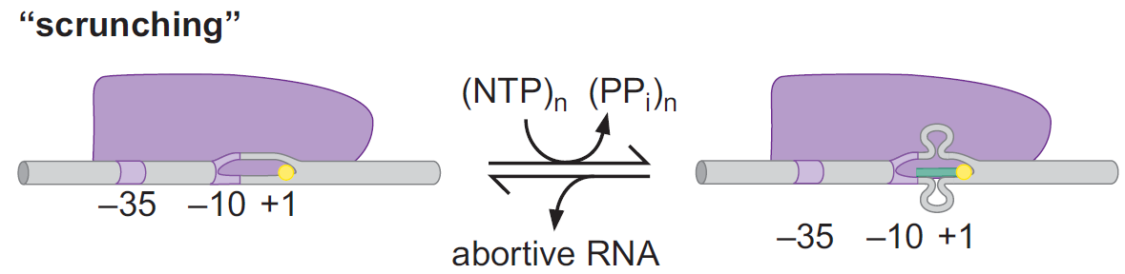
Mechanism of initial transcription
During initial transcription, the polymerase remains stationary on the promoter, unwinds downstream DNA, and pulls that DNA into itself.
It is not clear why RNA polymerase must undergo this period of abortive initiation before achieving escape.
It is believed that this process provides the energy required by polymerase to break the polymerase–promoter and core–s interactions associated with escape. Thus, scrunching is away to store and mobilize energy during transcription initiation, and its release upon escape is what enables polymerase to break free of the promoter and dislodge s factor from the core.
Notes:
It is not clear why RNA polymerase must undergo this period of abortive
initiation before achieving escape, but once again a region of the s factor
appears to be involved, acting as a molecular mimic.
It is
believed that this process provides the energy required by polymerase to
break the polymerase–promoter and core–s interactions associated with
escape. Thus, scrunching is away to store and mobilize energy during transcription
initiation, and its release upon escape is what enables polymerase
to break free of the promoter and dislodge s factor from the core.

Slide 6
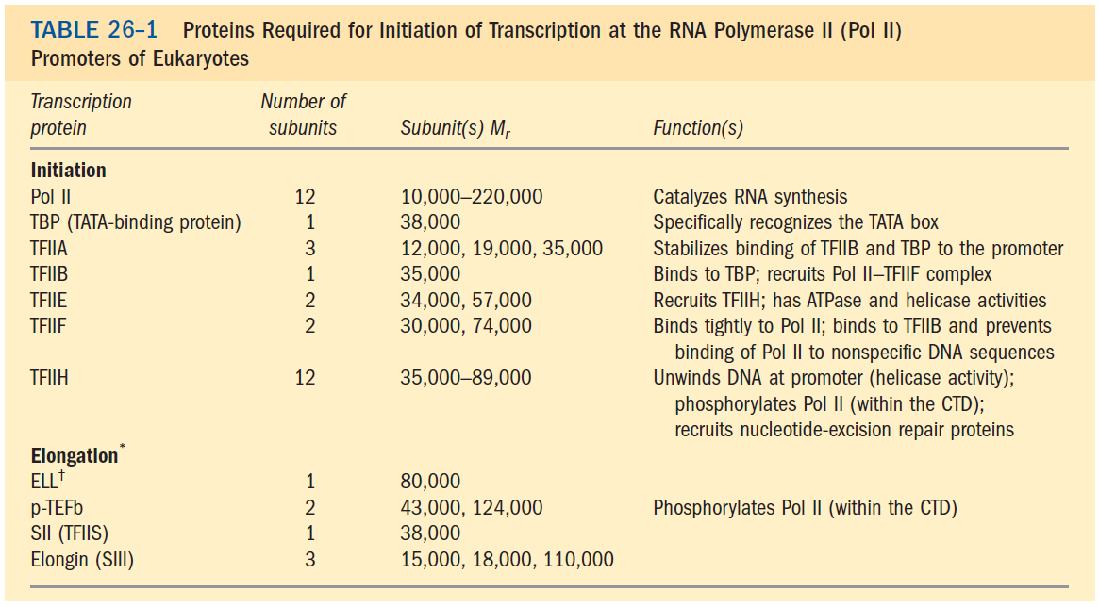

Slide 7
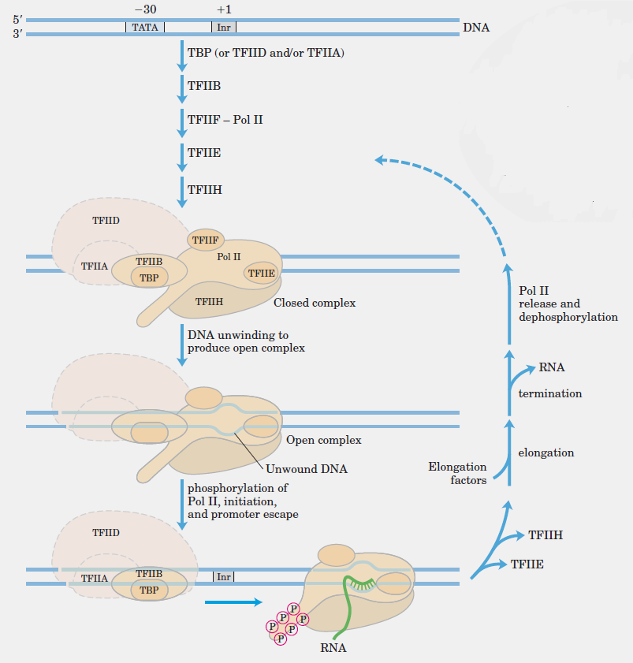
Transcription factor assembly at the promoter

Slide 8
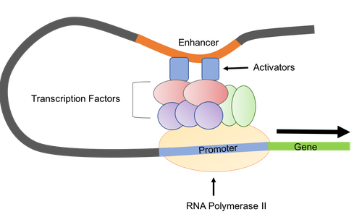
Enhancers
Enhancers are cis regulatory elements that increases the transcription rate of genes on the same molecule of DNA.
They can be found upstream, downstream, within the introns, or even relatively far away from the gene they regulate.
Multiple enhancers can act in a coordinated fashion to regulate transcription of a gene.

Slide 9
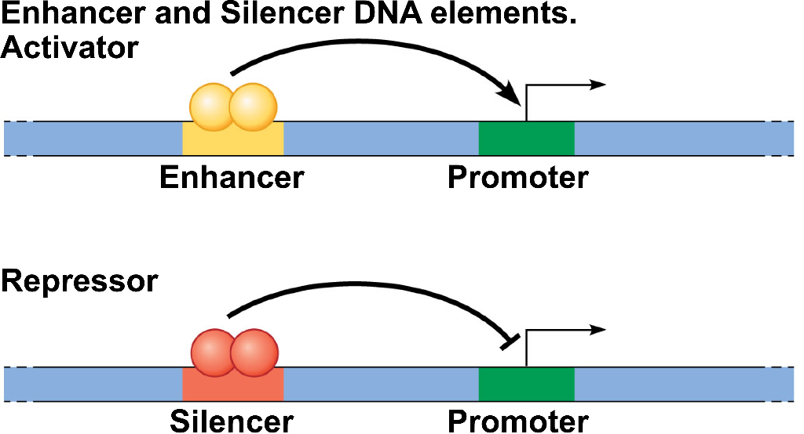
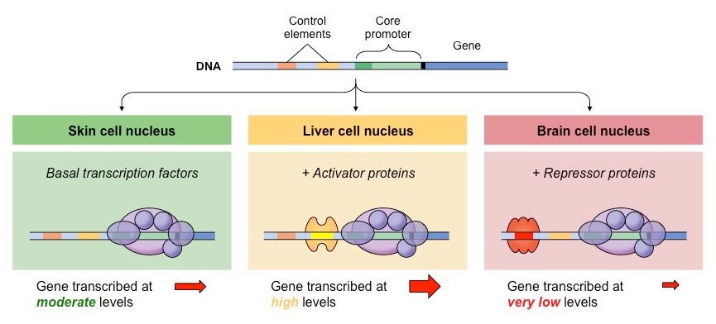
Silencers

Slide 10
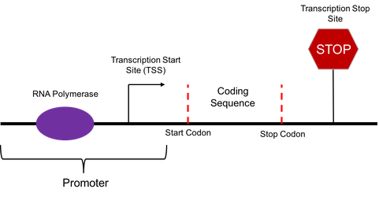
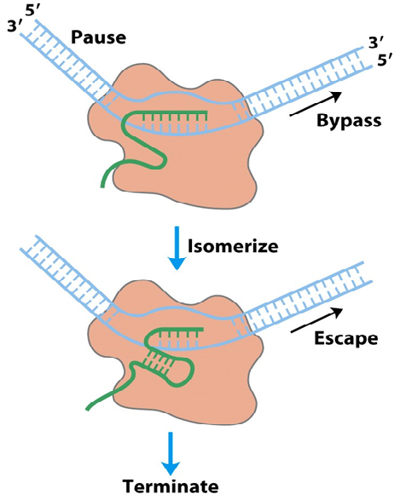
Transcription termination
Intrinsic terminators (Rho-independent)

Slide 11
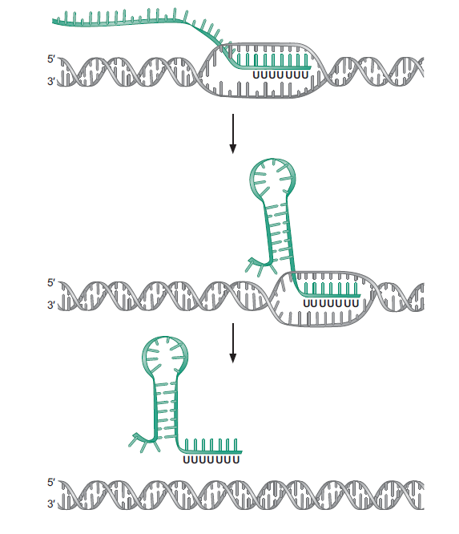
The hairpin works as an efficient terminator only when it is followed by a
stretch of A:U base pairs, because A:U base pairs are the weakest of all base pairs

Slide 12
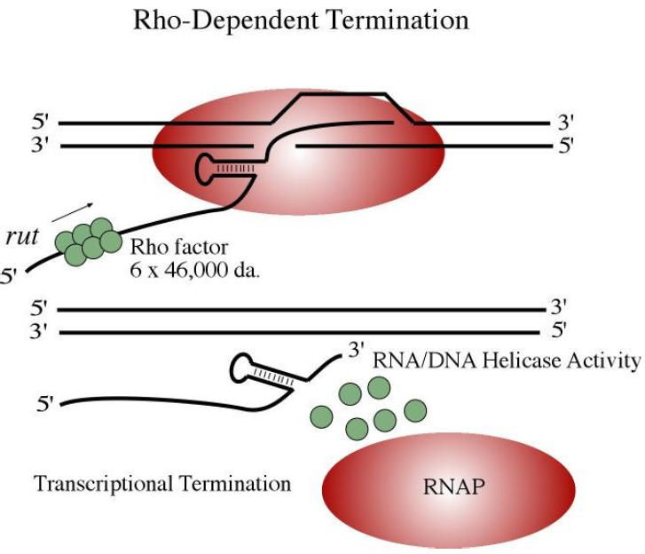
Notes:
Rho-dependent termination occurs by binding of Rho to ribosome-free mRNA, C-rich sites being good candidates for binding. Rho's ATPase is activated by Rho-mRNA binding, and provides the energy for Rho translocation along the mRNA; translocation requires sliding of the message into the central hole of the hexamer. When a polymerase pause site is encountered, the actual termination occurs, and the transcript is released by Rho's helicase activity.

Slide 13
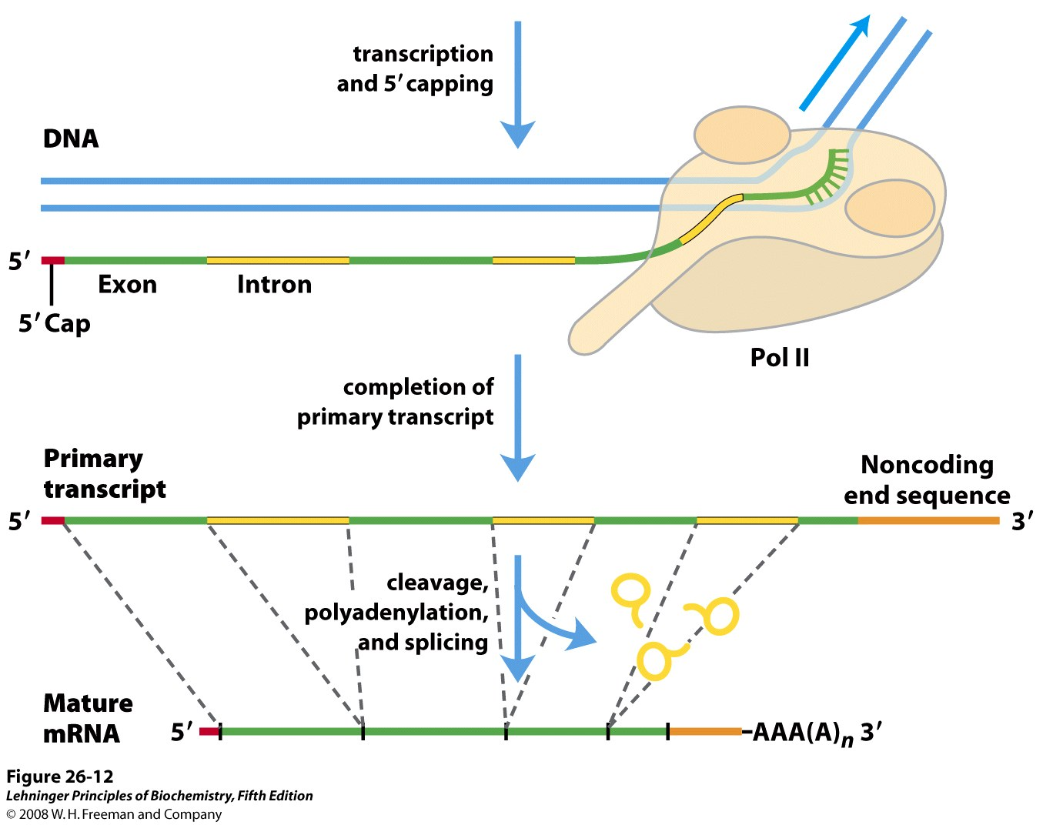
RNA processing

